Slide 1
DATA-DRIVEN INSIGHTS AND RECOMMENDATIONS
RECOMMENDER ENGINE

Slide 2

PROBLEM STATEMENT
RECOMMENDING CONTENT
▸ Creating moments of truth – how do we help a user to find something engaging within a few seconds?
▸ How do we build superior a recommendation engine – to drive superior loyalty and growth?
▸ You are after actionable insights to help decision-making and amplify customer lifetime value

Slide 3
BUSINESS VALUE
RECOMMENDING CONTENT
Growing the business on massive scale, becoming a producer and distributor of shows and movies with a fully global reach
Preventing abandonment of our service for an alternative entertainment option

Slide 4


Our Approach – provide users with personalised experience from the very beginning
RECOMMENDING CONTENT
▸ Recommendations tailored to each specific user
▸ Also applicable to anonymous users
Director Genre Actors
Release Year
▸ Improve user experience and satisfaction
▸ Decrease the time spent searching for relevant content

Slide 5
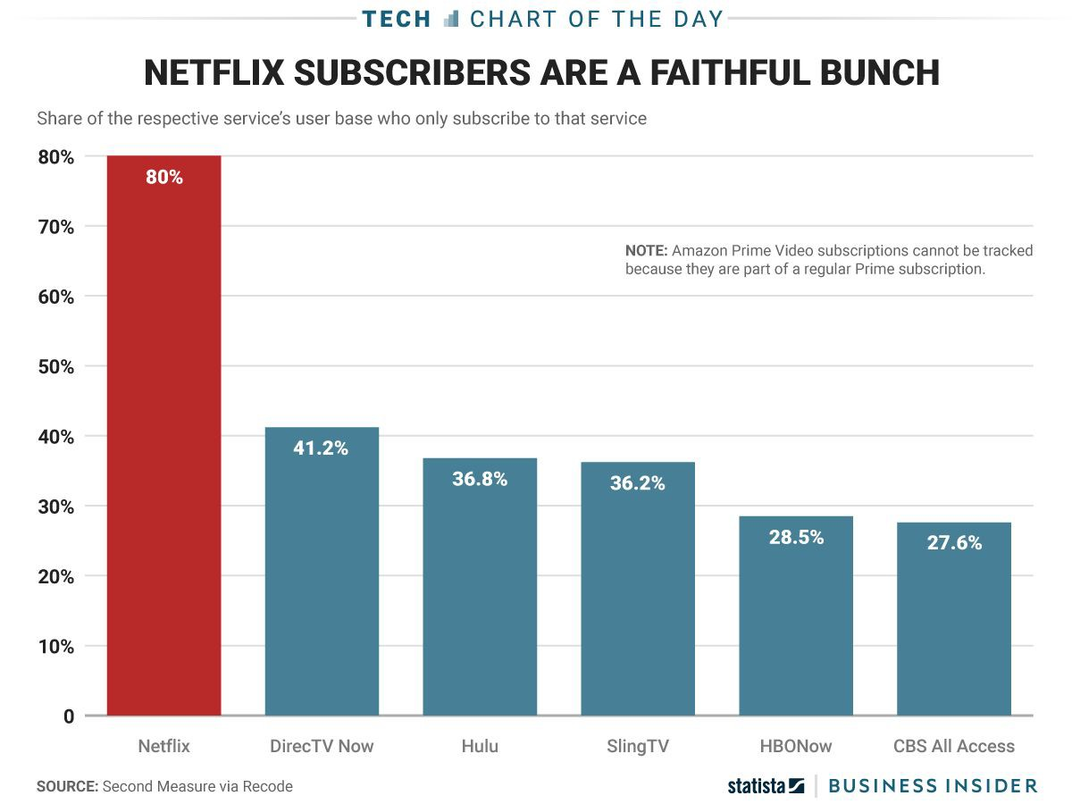
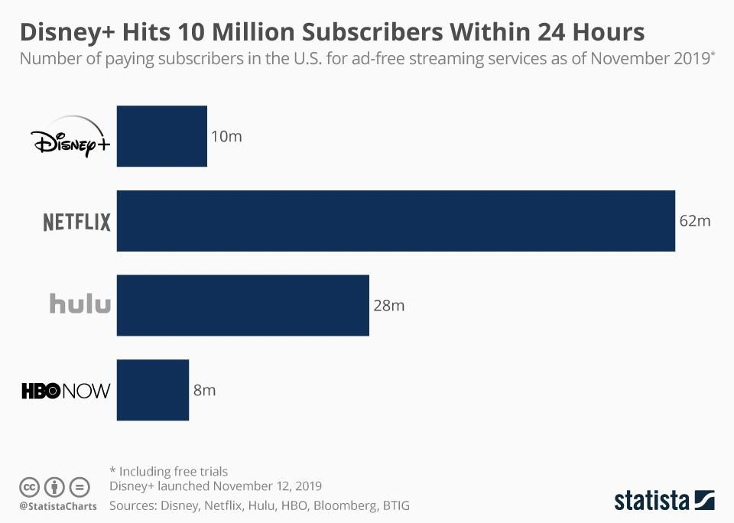
Securing Loyalty: Netﬂix

Slide 6
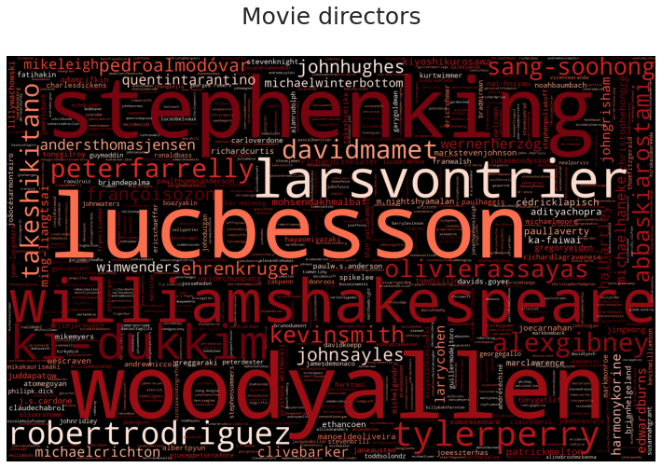
RECOMMENDING CONTENT
MOVIE DIRECTORS

Slide 7
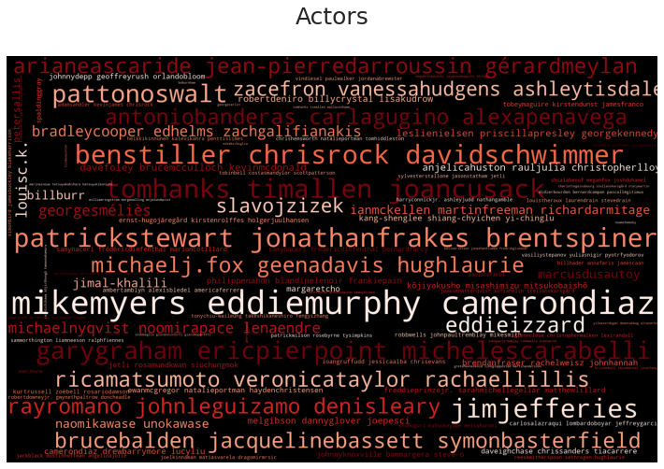
RECOMMENDING CONTENT
SOME ACTORS CAN DO NO WRONG!

Slide 8
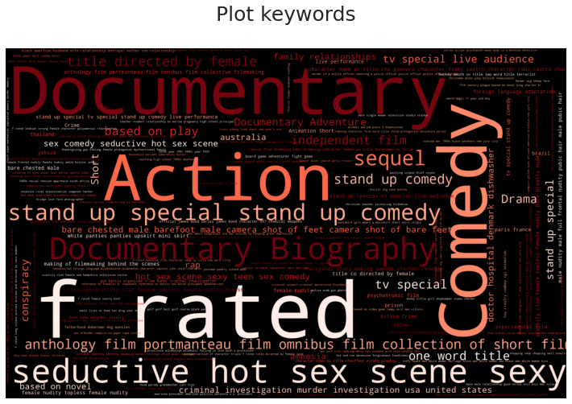
RECOMMENDING CONTENT
GENRES ARE IMPORTANT

Slide 9
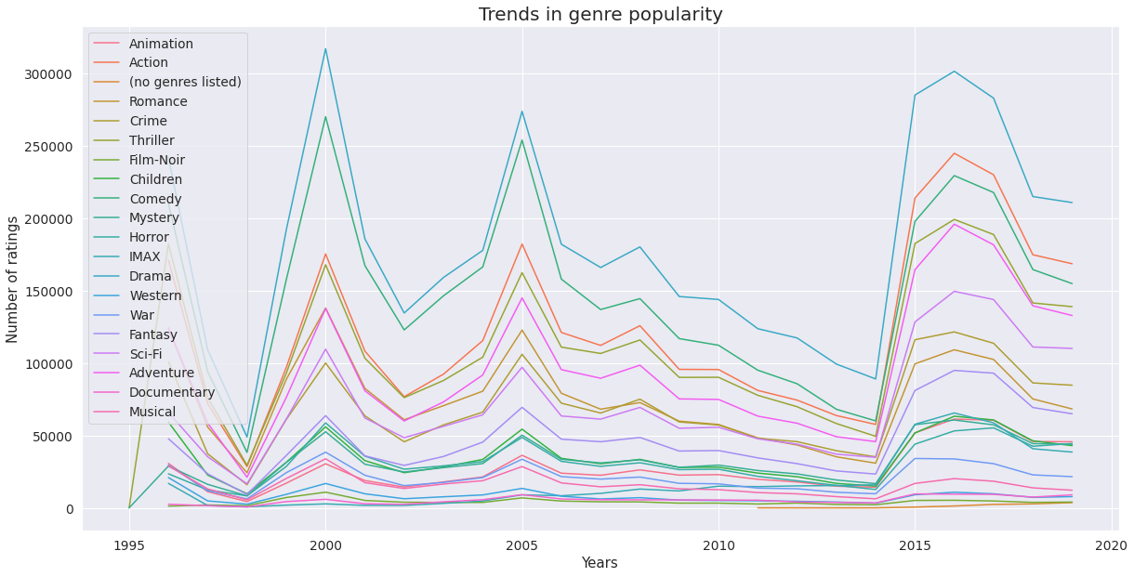
MAKING MOVIES
RELEASE YEAR

Slide 10
RECOMMENATIONS
MAKING MOVIES
▸ Movie Directors – impacts reviews and viewer perception
▸ Genre: Documentary, biography, conspiracy
▸ Actors: Film cast is important
▸ Release Year: Ratings Spike / Dip every 3-5 years
▸ Show users newly released content based on each user’s preference

Slide 11
Our Recommendation System
Using the dataset from MovieLens

Slide 12
IMPLEMENTATION
▹ Gather data
▹ Build and train a model
▹ Addressing the “Cold start” problem
▹ Deploying the App
14

Slide 13
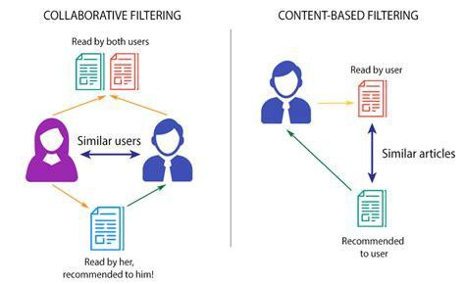

Slide 14
RESULTS MODELS TESTED
Algorithm Name | RMSE
Singular-Value Decomposition (SVD) | .70
KNN Basic | .96
KNN Baseline | .87

Slide 15
FUTURE WORK
RECOMMENDING CONTENT
▸ Aids in the selection process for undecided customer
▸ Natural Language Processing based recommendations
▸ Sentiment analysis of reviews
▸ Analysis of screenplay source e.g. based on novel vs original

Slide 16

THANK YOU

Slide 17
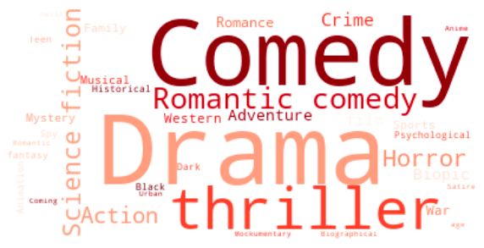
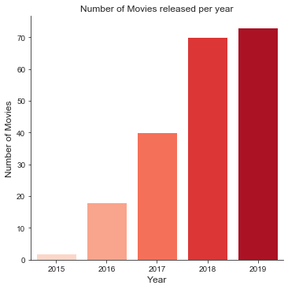
APPENDIX - NETFLIX ORIGINAL MOVIES
RECOMMENDING CONTENT
Runtime:
~ 99 minutes
Release month: November/December

Slide 18
RECOMMENDING CONTENT
APPENDIX - LIFECYCLE
Define Problem
Insights & Advice
Data Mining
Data Exploration &
Visualisations
Data Cleaning

